Slide 1


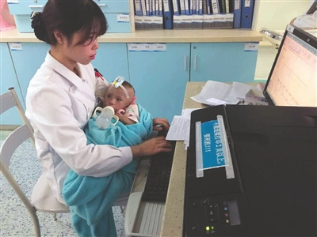
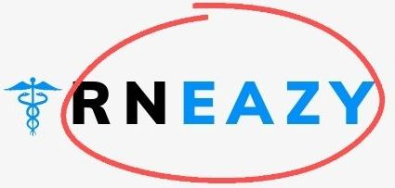

RNEAZY: a real-time voice-to-text downloadable software for nurses Our Story / Why Us?
Juggling Life-Work Balance
Family
Burnout
Notes:
( Tagline Needed ) Making
Name ideas: VTforRN, doc4nurse ,RNTransScribe, NurseDictate, RNScribe
Hello fellow nurses – Was there a time you were overwhelmed by amount of unfinished documentation?
have you finished your shift and realized you did not document something? Have you gone home hours late because you have to finish your documentation? And do you still remember our code: Not written, not done. I have been stressed numerous times because I had 6+ pts' VS and had to find time to document them.
Average of 3 hrs of time during a 12-hr is spent on writing and reviewing documentation - which is time nurses can spend at the bedside, doing direct patient care.
https://www.ncbi.nlm.nih.gov/pmc/articles/PMC6371290/
https://academic.oup.com/jamia/article/18/2/112/2909113
Transcribers exist in and out of healthcare but NOT FOR NURSES
We are a team of nurses, engineer and a management consultant.
For inpatient medical/surgical nurses, we are helping you decrease your time in documentation and make it easy by creating a real-time customized speech-to-text downloadable software trasnferrable to EHR.
Nurses, was there a time it was the end of the shift and you had so much left to document? Have you went home and realized that you did not document something?
Our service is to help nurses document in real-time through voice-to-text service for a timely and accurate manner.
We are a team of three nurses/APRN, one engineer and one mgmt consultant who have been drowned in nursing documentation and have grit to move this project forward.
We are creating Siri who can write for nurses. Say up front: We help real-time nursing documentation, increasing documentation speed, accuracy, and satisfaction through creating a speech-to-text technology.
RNEasy is a simple voice-to-text software downloadable in any device for inpatient medical/surgical nurses

Slide 2



RNEAZY: Problem
Challenge is the lack of real-time efficient and accurate transcriber that saves time for nurses.
Documentation Time & errors
Notes:
Challenge is the lack of real-time efficient and accurate transcriber that saves time.
Nurses spend 26-35% of their time during a shift for documentation. New nurses and nursing students spend tremendous amount of time learning how to document. The time allocated in documentation allows less time for nurses to deliver direct patient care, assessment and/or medication administration.
Niche: High nurse-to-patient ratio Medical/Surgical nurses with limited time for documentation
Common documentation errors stem from delayed documentation and failure to date an entry
https://www.wolterskluwer.com/en/expert-insights/nursing-documentation-how-to-avoid-the-most-common-medical-documentation-errors
https://www.ncbi.nlm.nih.gov/pmc/articles/PMC3037121/
Nurses reported they used 35.3% of their shift time for documentation and 80.6% spent time at the nurses station for documentation. 1.3% documented off the unit.
https://pubmed.ncbi.nlm.nih.gov/32159770/
We identified a total of 1647 articles, of which 33 met our inclusion criteria. Twenty-one studies reported the impact of 12 different health information technology (HIT) implementations on nurses’ documenta- tion time. Weighted averages were calculated for studies that implemented barcode medication administration (BCMA) and 2 weighted averages for those that implemented EHRs, as these studies used different sampling units; both showed an increase in the time spent in documentation (þ22% and þ46%).
https://www.ncbi.nlm.nih.gov/pmc/articles/PMC6371290/
Lengthy documentation time has been a major challenge in the current EHR environment. Studies reported nurses spent 26.2 - 41% of their time on documentation
https://academic.oup.com/jamia/article/18/2/112/2909113
This was done to emphasize clinical rather than administrative communication. If billing and records were included, then attending notes were viewed 97% of the time, and resident notes were viewed 99% of the time; the other user groups were less affected. Fewer than 20% of nursing notes were read by attendings or residents, and only 38% were read by other nurses.
Notes: Efficient here means our solution mitigates the challenges with the other competitors in the market
Words pronounced with an accent
Speaking too quickly
Speaking too loudly
Speaking too quietly
Background noise

Slide 3


RNEAZY: Market Potential and Our Niche offering
The global medical transcription software market size was valued at $1.32 Billion in 2019 & is projected to reach $4.89 Billion by 2027.
Voice-to-text technology can Improve documentation time, quality and services provided by healthcare providers by 26%.
It can also reduce cost and help in legal settings.
Notes:
Market
Nurses spend 26-35% of their time during a shift for documentation. New nurses and nursing students spend tremendous amount of time learning how to document.
Niche
Nurses in Busy Inpatient Medical Surgical Unit
This can be expanded to other area
Voice-to-text technology can improve documentation time, quality and service provided by healthcare providers. It can also reduce cost and help in legal settings. https://pubmed.ncbi.nlm.nih.gov/27808064/
https://pubmed.ncbi.nlm.nih.gov/26531850/
The number of clinical reports eligible for further analysis stood at 1455. Out of 1455 reports, 718 (49.35%) were assisted by ASR and 737 (50.65%) were not assisted by ASR. Average documentation speed without ASR was 173 (SD 101) characters per minute, while it was 217 (SD 120) characters per minute using ASR. The overall increase in documentation speed through Web-based ASR assistance was 26% (P=.04).

Slide 4
RNEAZY: Existing Competitors
RNEAZY
Nurse's documentation
Receiving notes,
Initial assessment, VS, medication, fluid balance chart,
Hand-over notes, etc
Hourly Rounds, Education
Change of Shift
Amazon Transcribe Medical
Health Care Clinician But Not For Nurses
Nuance Dragon Medical
Makes Controllers & Uses Phone
Next GenHealth Care EHR
Mmodel Fluency
SNChart
Dolbey Fusion Narrate
EcareNotes
Notes:
Voice-to-text services and apps are available in the market. Amazon has launched Transcribe Medical for healthcare providers in 2017. However, a voice-to-text service targeting nurses for vital signs and specific head-to-toe nursing assessment documentation does not exist in the market.
Nuance Dragon Medical One makes controllers and a clinician can utilize their personal phones for transcribing voice as text for note taking. https://www.nuance.com/healthcare/provider-solutions/speech-recognition.html Our distinguishing feature can be direct scribing to already existing EHR?
https://aws.amazon.com/transcribe/medical/
https://www.modernhealthcare.com/article/20151212/MAGAZINE/312129980/nurses-turn-to-speech-recognition-software-to-speed-documentation
"Epic is evaluating Florence, Nuance's voice-driven digital assistant with artificial intelligence. That project is currently in the prototype stage with no set launch date. “I could say blood pressure is 120 over 80 and that would go right into our nursing flow sheet,” Johnson said, explaining a potential use." In Dec 2015

Slide 5
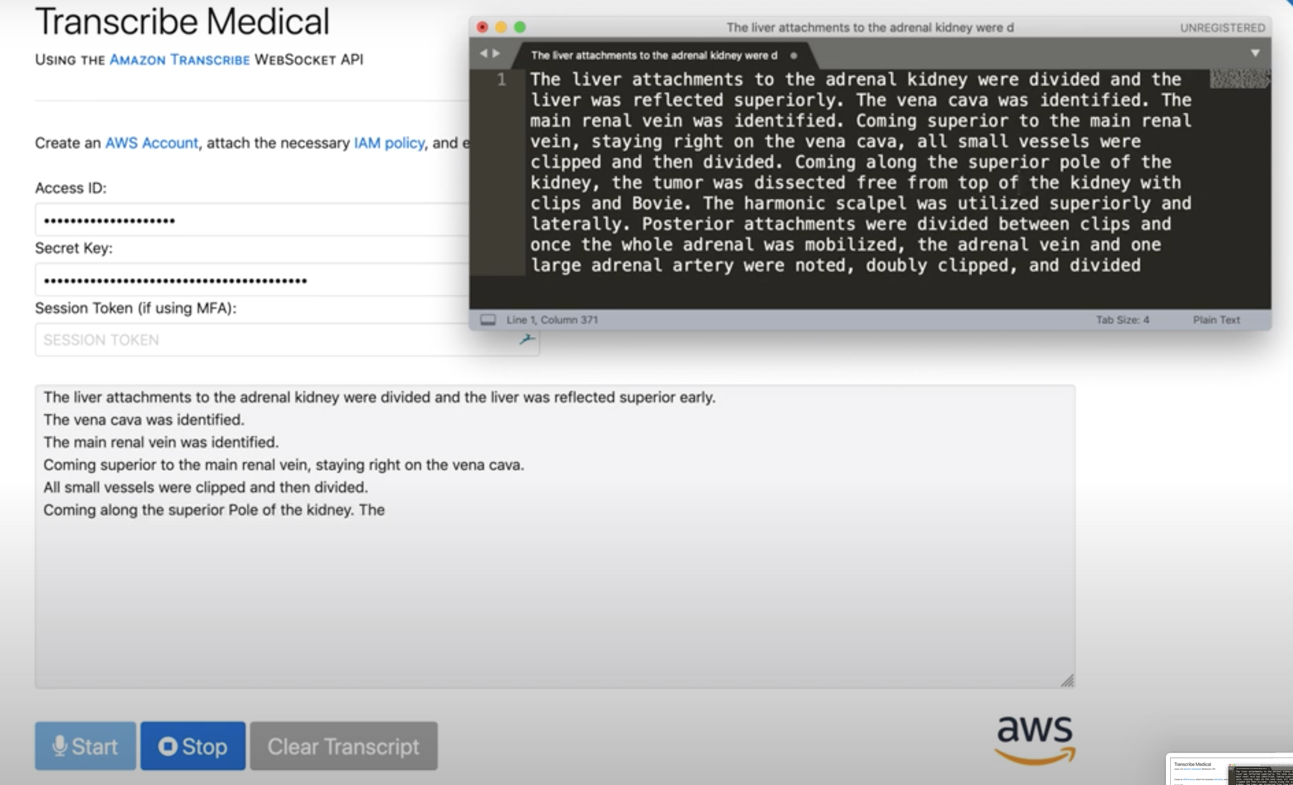
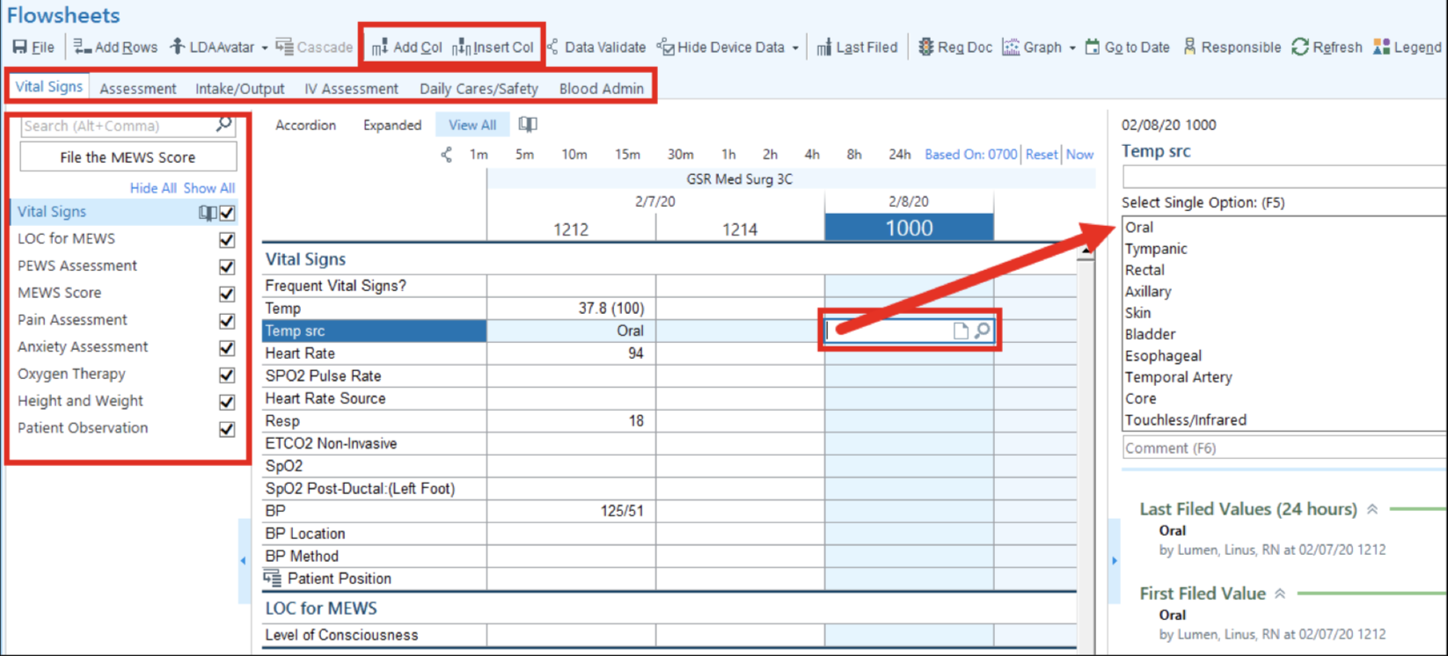
RNEAZY: Existing Competitors
Notes:
Voice-to-text services and apps are available in the market. Amazon has launched Transcribe Medical for healthcare providers in 2017. However, a voice-to-text service targeting nurses for vital signs and specific head-to-toe nursing assessment documentation does not exist in the market.
Nuance Dragon Medical One makes controllers and a clinician can utilize their personal phones for transcribing voice as text for note taking. https://www.nuance.com/healthcare/provider-solutions/speech-recognition.html Our distinguishing feature can be direct scribing to already existing EHR?
https://aws.amazon.com/transcribe/medical/
https://www.modernhealthcare.com/article/20151212/MAGAZINE/312129980/nurses-turn-to-speech-recognition-software-to-speed-documentation
"Epic is evaluating Florence, Nuance's voice-driven digital assistant with artificial intelligence. That project is currently in the prototype stage with no set launch date. “I could say blood pressure is 120 over 80 and that would go right into our nursing flow sheet,” Johnson said, explaining a potential use." In Dec 2015

Slide 6
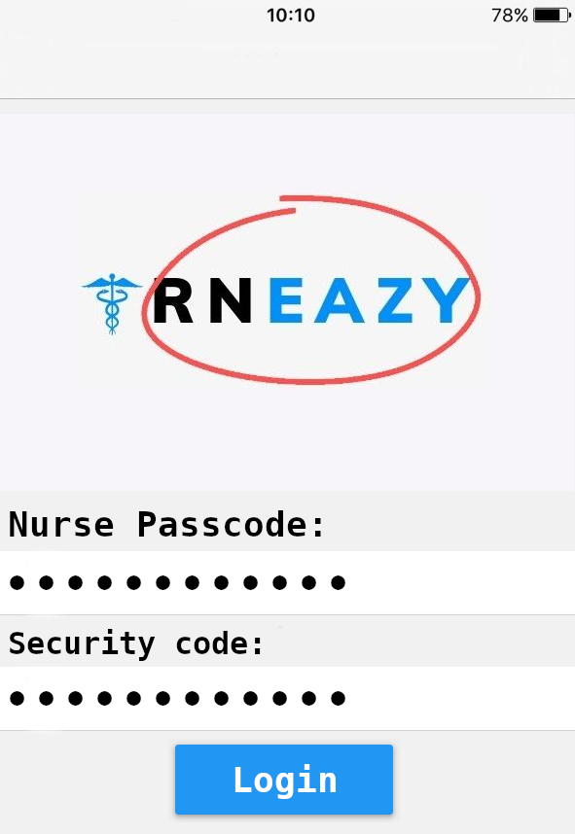
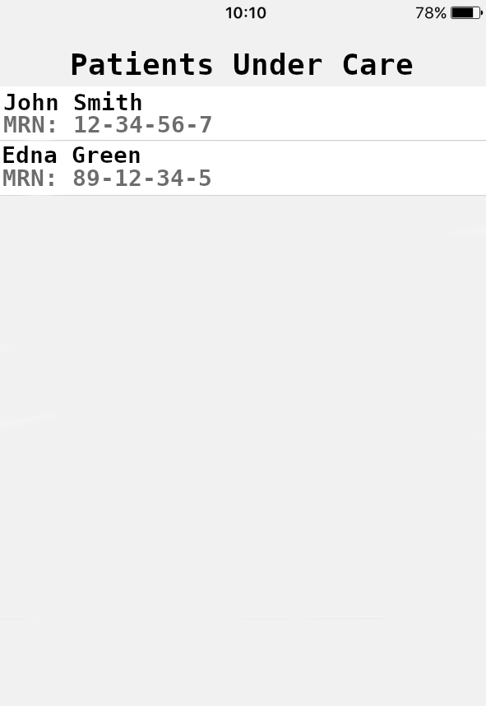
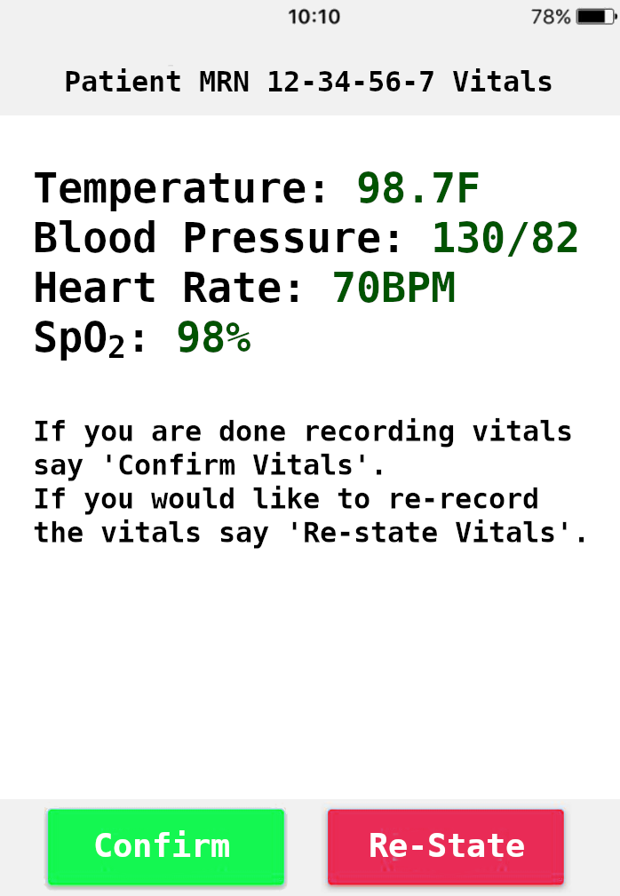
RNEAZY: MVP Examples
Notes:
Voice-to-text services and apps are available in the market. Amazon has launched Transcribe Medical for healthcare providers in 2017. However, a voice-to-text service targeting nurses for vital signs and specific head-to-toe nursing assessment documentation does not exist in the market.
Nuance Dragon Medical One makes controllers and a clinician can utilize their personal phones for transcribing voice as text for note taking. https://www.nuance.com/healthcare/provider-solutions/speech-recognition.html Our distinguishing feature can be direct scribing to already existing EHR?
https://aws.amazon.com/transcribe/medical/
https://www.modernhealthcare.com/article/20151212/MAGAZINE/312129980/nurses-turn-to-speech-recognition-software-to-speed-documentation
"Epic is evaluating Florence, Nuance's voice-driven digital assistant with artificial intelligence. That project is currently in the prototype stage with no set launch date. “I could say blood pressure is 120 over 80 and that would go right into our nursing flow sheet,” Johnson said, explaining a potential use." In Dec 2015

Slide 7
RNEAZY: System Workflow
Keywords to start/stop recording
Hands-free device/personal phone
Log in to our service
Speak MRN #
Record assessment and procedures
Speech transferred to EHR
Log out
Identify returning RN
Security /HIPAA
Multi-Factor Authentication
Audit Trail
Notes:
Can we make it like Siri?
Make it compatible with android/apple
User interact – hand held recorder? Tranfer? Interface?
What should it do? A service that is downloadable in personal phones and protected by encryption, hands-free, specifically for high nurse-to-patient ratio med/surg nurses
What should it not do? NOT a translator, not a conversation-based scriber.
This device will have to integrate with existing API EHR for speech to transferred to HER. Integration of this downloadable application would need agreement between our product and medical facilities.
Own interface, multiple usages, Data is in the cloud.
piece of downloadable software you can download in any device.
User designer to display.
Option to go to back to the data and audit in the future.
Implementation cost
Scalability- Application could be used on any device
We are creating a voice-to-text service tailored for nurses to decrease the amount of time spent on documenting vital signs and nursing assessments. This real time documentation service aims for easier and more efficient workflow of nurses.
We are creating Siri who can write for nurses.

Slide 8





RNEAZY: System Workflow Security & HIPAA
Two Step Verification
Password
Security Token
Notes:
HIPAA will be ensured by strong encryption. Recorded audio and transcribbed text of the audio will be temporarily stored on the hands-free device. Encryption will be used for storage on the device as well as when transferring transcribbed data from the device to the EMR to protect patient safety.

Slide 9
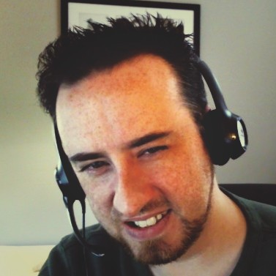

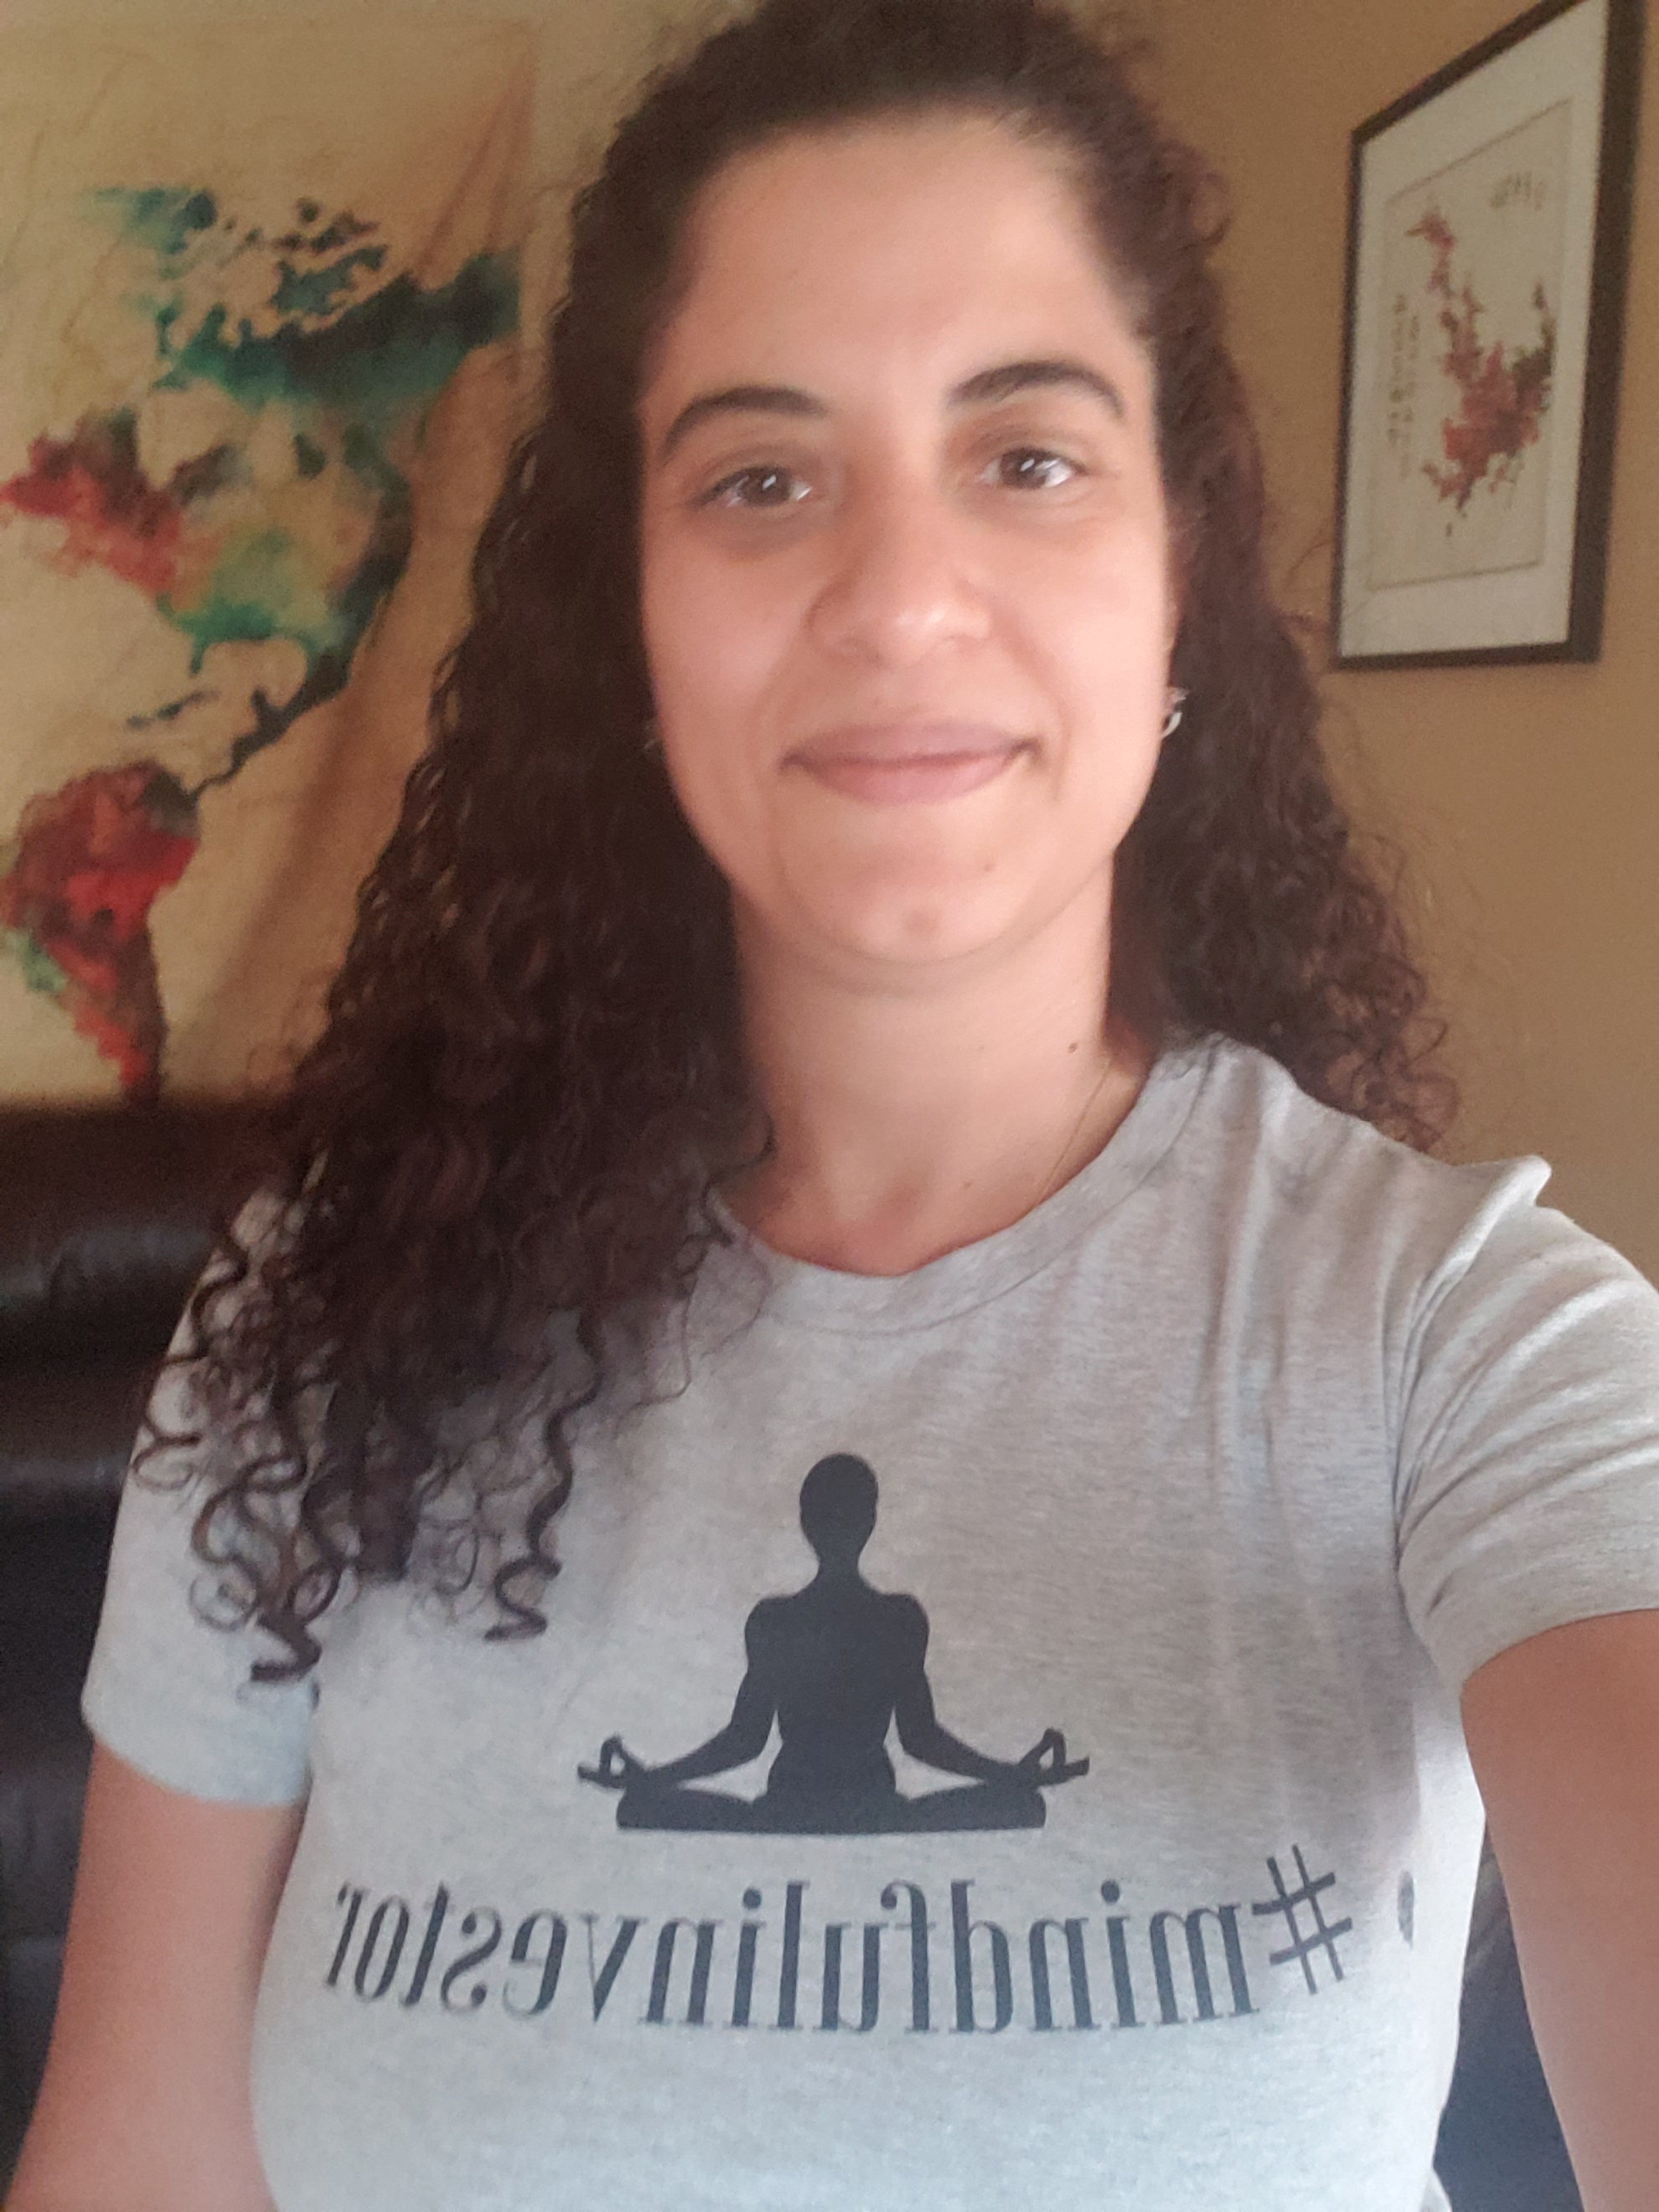
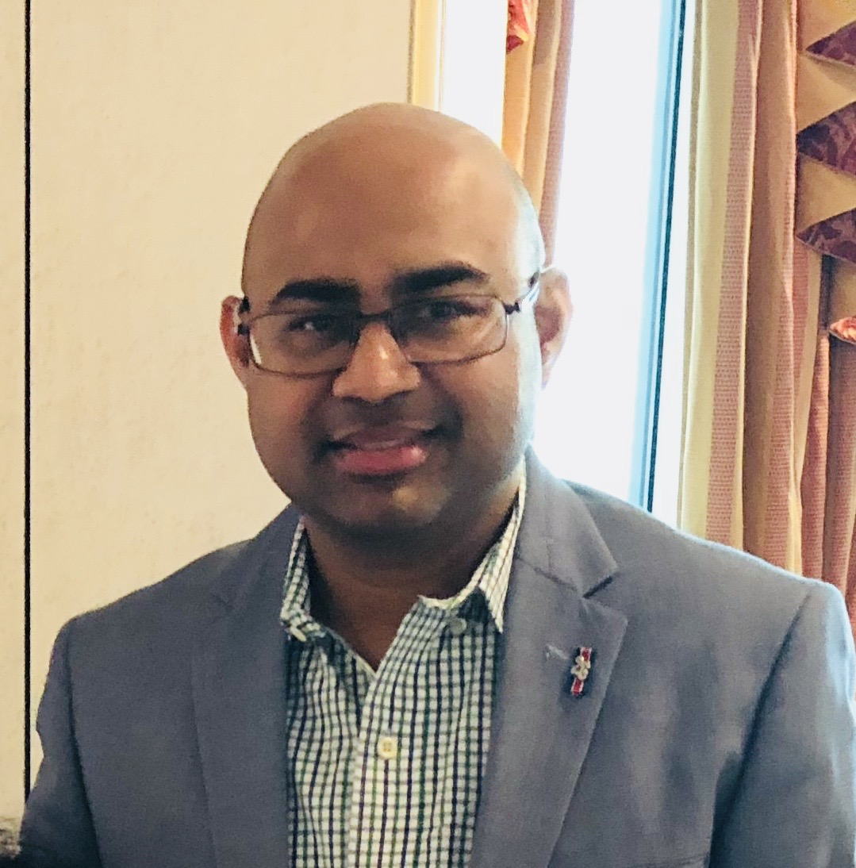
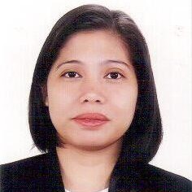

RNEAZY: The Team / Questions?
Fraser Gutteridge
Programmer
Jiwon Lee
RN
Damaris Grossmann
APRN
Swapan Roy Mgmt. Consultant
Myra Teano
RN
LinkedIn
LinkedIn
LinkedIn
LinkedIn
LinkedIn
Notes:
Add a story – thanks to RNEasy, now I have an hour with my patients - crying, laughing and be present with them!

